Slide 2
Chapter 3

Slide 3
Generate-And-Test
1.Generate a possible solution. 2.Test to see if this is the expected solution. 3.If the solution has been found quit else go to step 1.

Slide 4
Types of G&T
Systematic G.T(No backtracking)
Heuristic G.T
Plan G.T

Slide 5
Simple Hill Climbing
Step 1 : Evaluate the initial state. If it is a goal state then stop and return success. Otherwise, make initial state as current state.
Step 2 : Loop until the solution state is found or there are no new operators present which can be applied to the current state.
a) Select a state that has not been yet applied to the current state and apply it to produce a new state.
b) Perform these to evaluate new state i. If the current state is a goal state, then stop and return success. ii. If it is better than the current state, then make it current state and proceed further. iii. If it is not better than the current state, then continue in the loop until a solution is found. Step 3 : Exit.

Slide 6
1 2 3
4 5 0 heuristic : no of correct placed tiles : 07
7 8 6
Down , up, left
down 12 3
4 5 8
7 8 0 heuristic :09

Slide 7
Steepest Ascent Hill climbing
Step 1 : Evaluate the initial state. If it is goal state then exit else make the current state as initial state Step 2 : Repeat these steps until a solution is found or current state does not change
i. Let ‘target’ be a state such that any successor of the current state will be better than it;
ii. for each operator that applies to the current state a. apply the new operator and create a new state b. evaluate the new state c. if this state is goal state then quit else compare with ‘target’ d. if this state is better than ‘target’, set this state as ‘target’ e. if target is better than current state set current state to Target

Slide 8
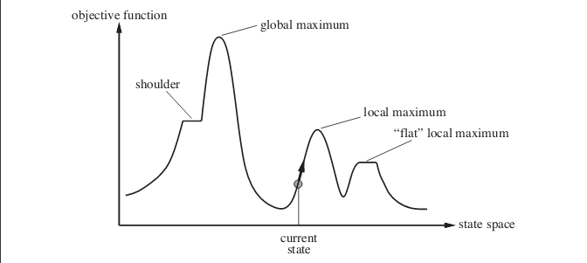

Slide 9
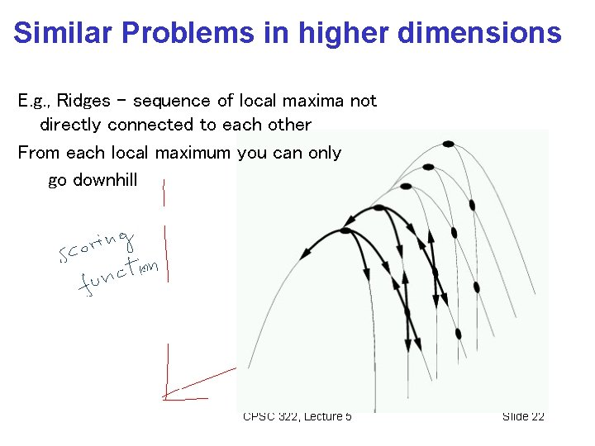

Slide 10
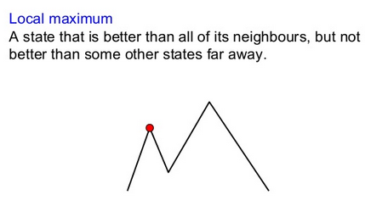
Local maxima

Slide 11
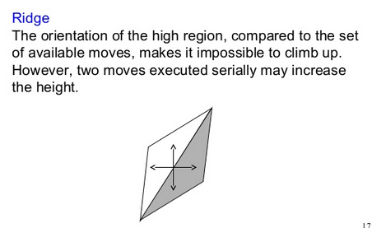
Ridge

Slide 12
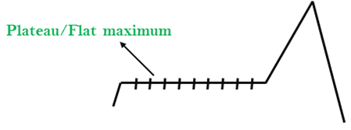
Plateau

Slide 13
Solution
To overcome local maximum problem : Utilize backtracking technique. Maintain a list of visited states. If the search reaches an undesirable state, it can backtrack to the previous configuration and explore a new path.
To overcome plateaus : Make a big jump. Randomly select a state far away from the current state. Chances are that we will land at a non-plateau region
To overcome Ridge : In this kind of obstacle, use two or more rules before testing. It implies moving in several directions at once.

Slide 14
Best First Search Algorithm
Input : Create 2 empty lists: OPEN and CLOSED
Step 1: Start from the initial node (say N) and put it in the ‘ordered’ OPEN list
Step 2: Repeat the next steps until GOAL node is reached
If OPEN list is empty, then EXIT the loop returning ‘False’
Select the first/top node (say N) in the OPEN list and move it to the CLOSED list. Also capture the information of the parent node
If N is a GOAL node, then move the node to the Closed list and exit the loop returning ‘True’. The solution can be found by backtracking the path
If N is not the GOAL node, expand node N to generate the ‘immediate’ next nodes linked to node N and add all those to the OPEN list
Reorder the nodes in the OPEN list in ascending order according to an evaluation function f(n)

Slide 15


Slide 16
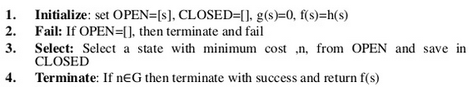
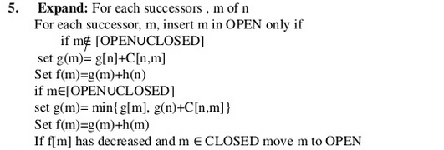
A* Algorithm

Slide 17
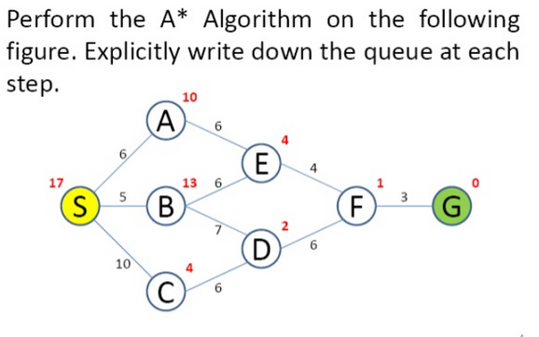

Slide 18
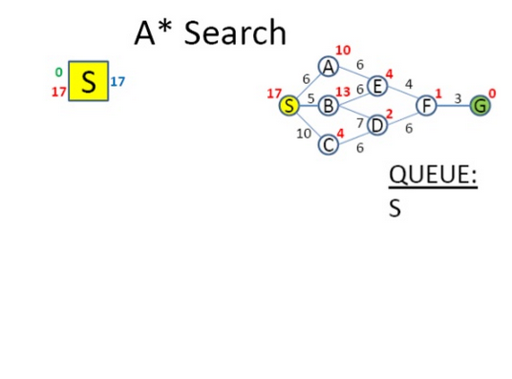

Slide 19
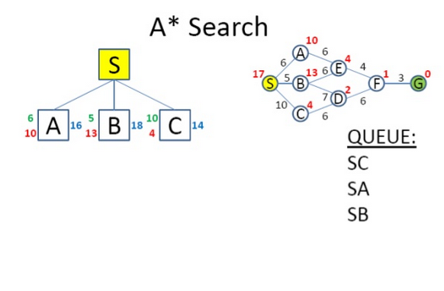

Slide 20
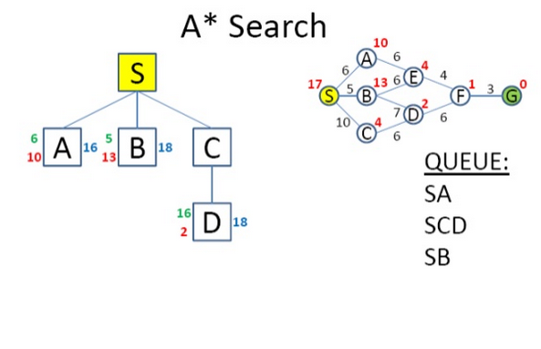

Slide 21
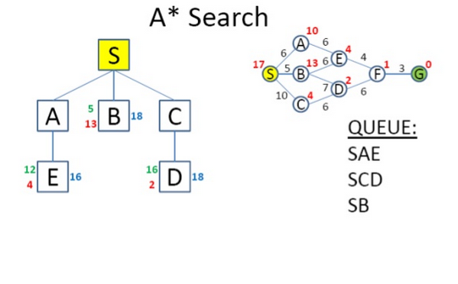

Slide 22
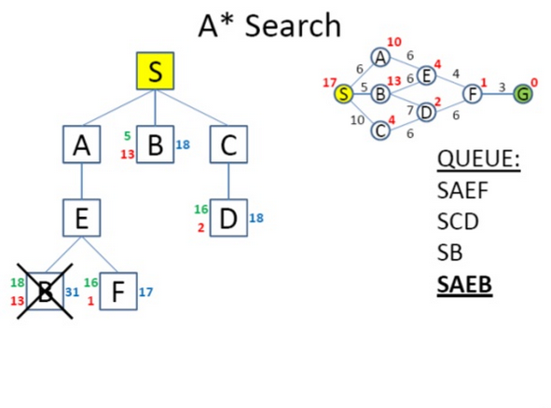

Slide 23
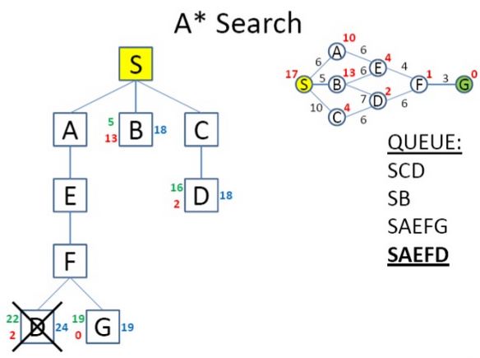

Slide 24
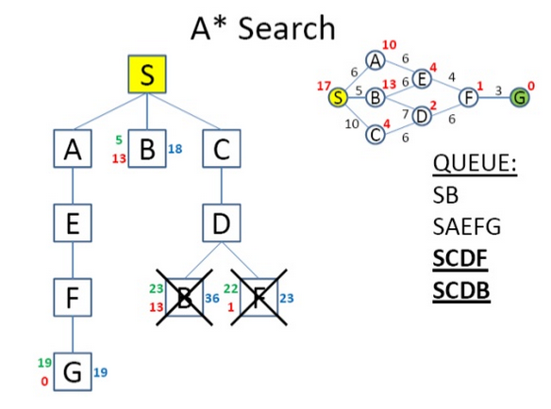

Slide 25
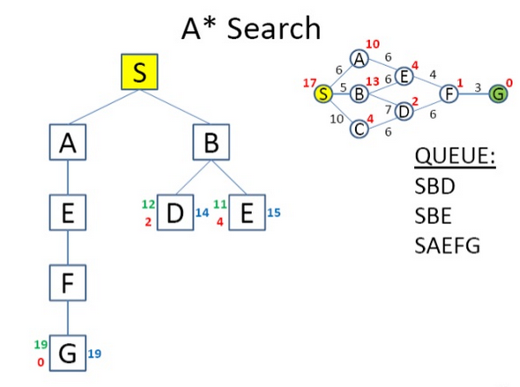

Slide 26
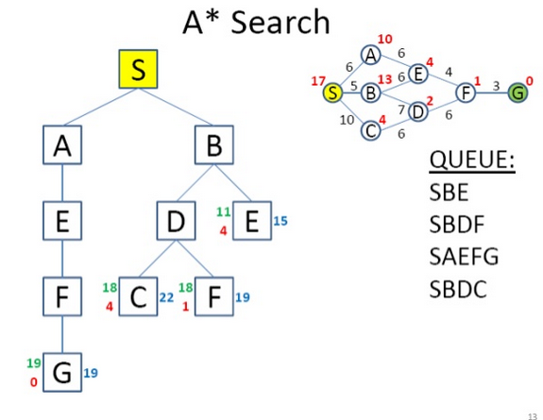

Slide 27
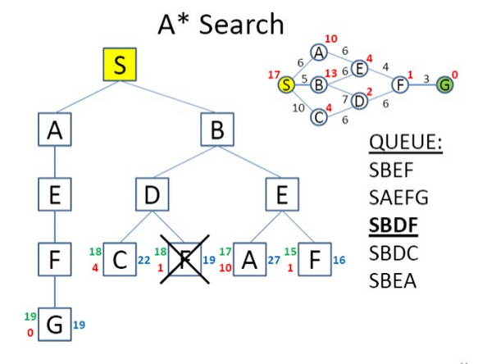

Slide 28
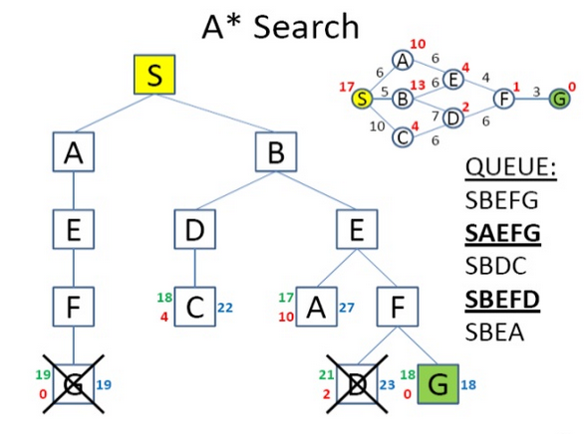

Slide 29
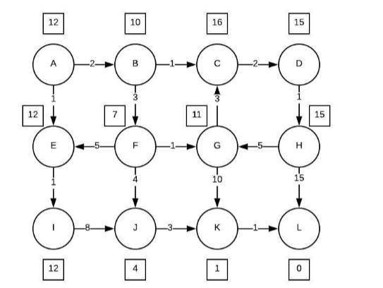
InclassExercise#1

Slide 30
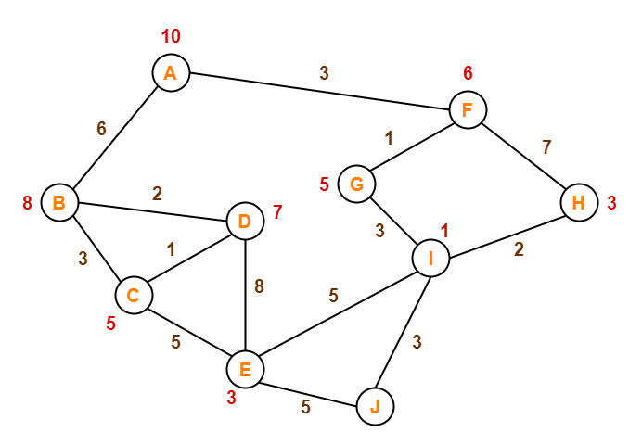
InclassExercise#2

Slide 31
Issues in A* algorithm
Is the A* admissible?
“If it never overestimates the cost of reaching the goal”
A* search : special cases
If g(n) 0, then f(n)=h(n)
If h(n)=0, then f(n)=g(n)
If h(n)=0 and unit cost for g(n) then f(n)=g(n)
If h(n) is perfect , search will find the goal without wastage of efforts.
If h(n) is not perfect then?

Slide 32
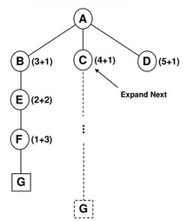
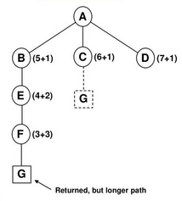
Suppose f’=g + h’, where h’ overestimates/underestimates
h’ overestimates h
h’ underestimates h

Slide 33
A* search Properties
Is it Complete?
Time ?
Space?
Optimal?

Slide 34
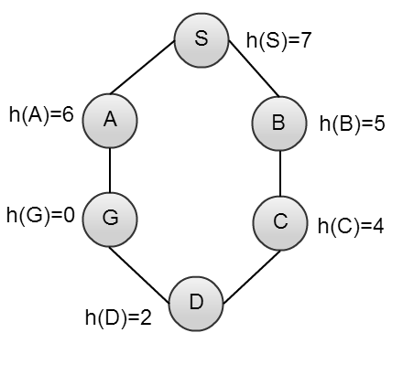
when would best first search be worse than simple breadth first search?

Slide 35
Problem Reduction
A1*A2
A2 *A3
(A1*A2)(A3*A4)
OR Graph : shows choice
AND Graph : shows decomposition of a problem

Slide 36
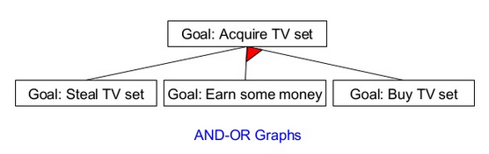

Slide 37
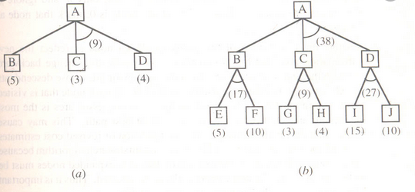

Slide 38
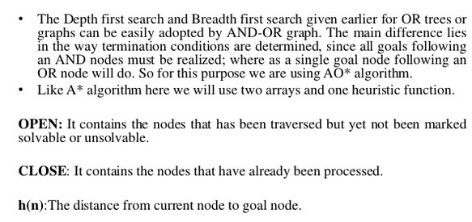
AND-OR Graph

Slide 39
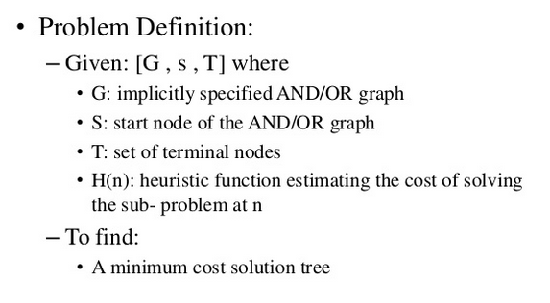
AND-OR Graph Search Problem

Slide 40
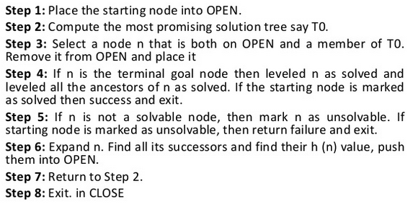
Algorithm

Slide 41
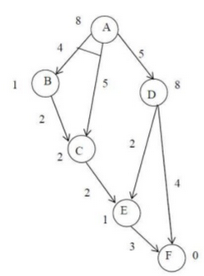
Example

Slide 42
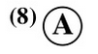

Slide 43
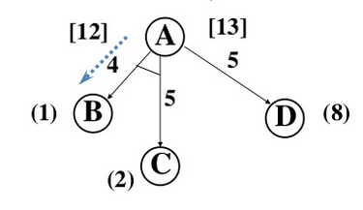

Slide 44
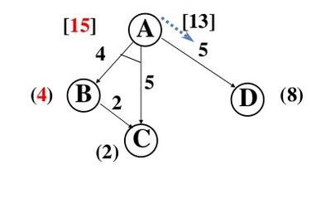

Slide 45
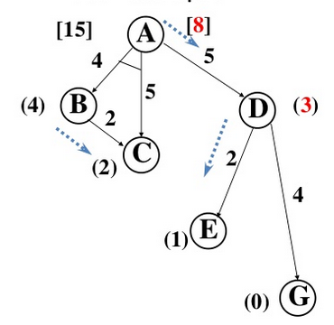

Slide 46
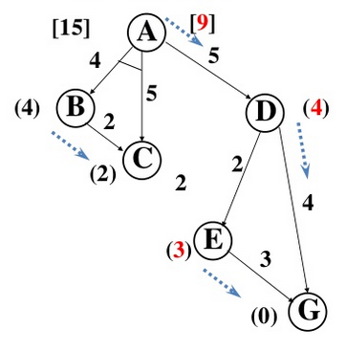

Slide 47
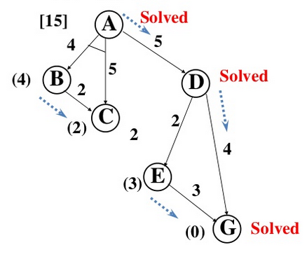

Slide 48
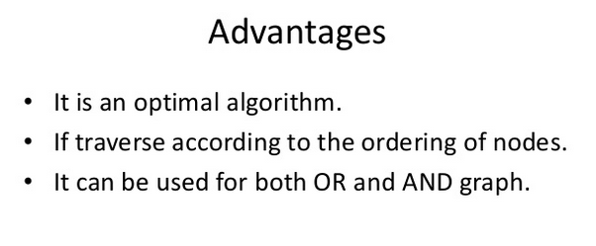

Slide 49
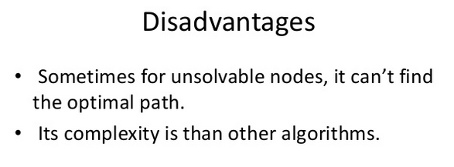

Slide 50
Inclass#Exercise

Slide 51
Constraint Satisfaction

Slide 52
Problem Statement
How to assign decimal digits to
letters, so that the following sum
is valid? Assume that we already
know that
The possible digits set for the letters is {0,1,2,…9};
M must be 1;
Two different letters can't be assigned the same digit
SEND
+ MORE
--------
MONEY

Slide 53
using c1,c2 and c3 to represent carries changing problem to solve 4 equations
C3 C2 C1
S E N D
+ D+E = Y+10*C1
M O R E C1+N+R = E+10*C2
C2+E+O = N+10*C3
---------------------- C3+S+M = O+10*M
M O N E Y

Slide 54
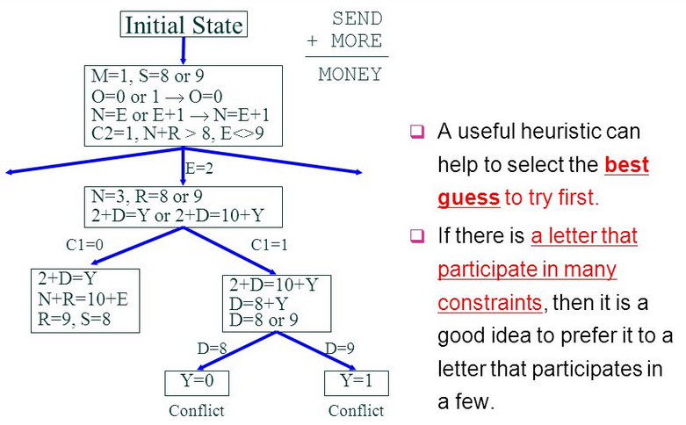

Slide 55
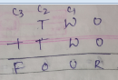

Slide 56
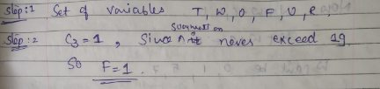

Slide 57
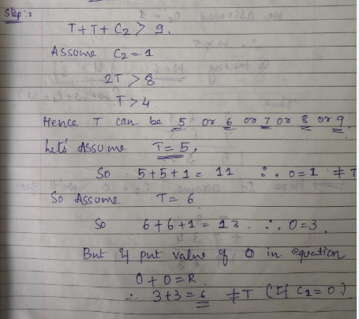

Slide 58
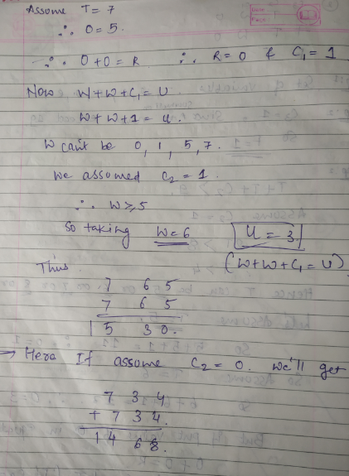

Slide 59
LOGIC + LOGIC = PROLOG

Slide 61
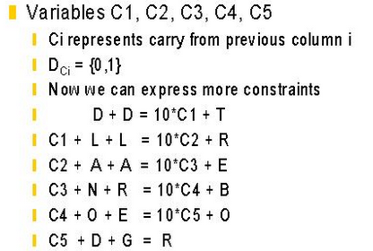

Slide 62
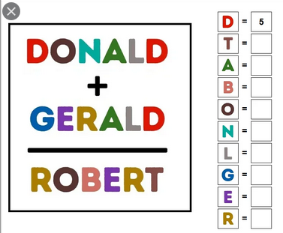

Slide 63
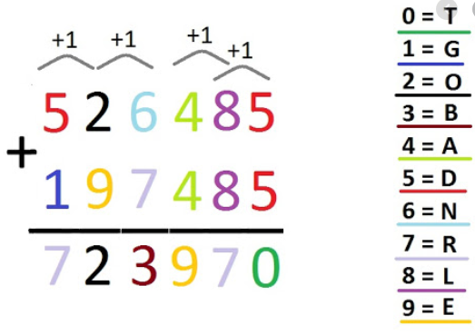

Slide 64
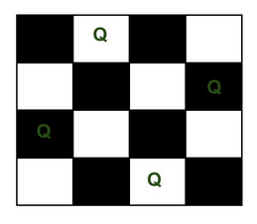
N-Queen Problem
The N Queen is the problem of placing N chess queens on an N×N chessboard so that no two queens attack each other.
4 Queen

Slide 65
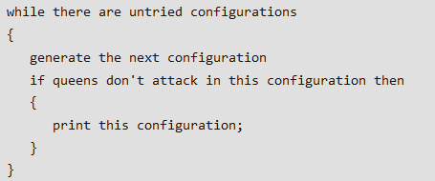
Basic Method
Generate all possible configurations of queens on board and print a configuration that satisfies the given constraints.

Slide 66
With Backtracking
The idea is to place queens one by one in different columns, starting from the leftmost column
When we place a queen in a column, we check for clashes with already placed queens.
In the current column, if we find a row for which there is no clash, we mark this row and column as part of the solution.
If we do not find such a row due to clashes then we backtrack and return false.

Slide 67
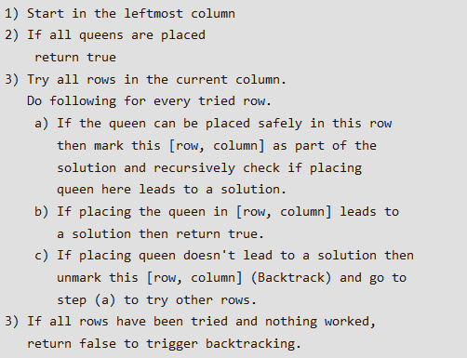

Slide 68
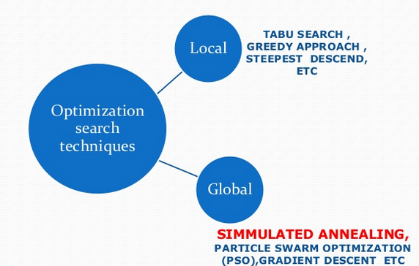
Simulated Annealing

Slide 69

Difficulty in searching Global Optima

Slide 70

Simulated Annealing

Slide 71

Consequences of the occasional ascents

Slide 72

What is Annealing?

Slide 73


Slide 74

Relation between physical annealing and simulated annealing

Slide 75

Stopping Crieteria

Slide 76


Slide 77

Algorithm:

Slide 78


Slide 79

Applications

Slide 80

Advantages

Slide 81

Conclusion

